Slide 1
Software Engineering and Architecture
Distributed Systems
An Introduction

Slide 2
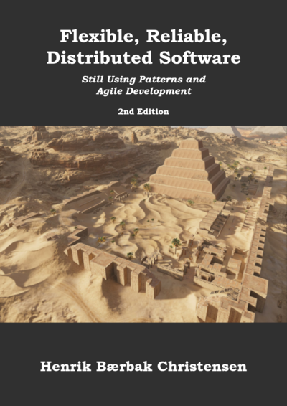
Intro…
Distributed Computing is the last major SWEA topic
  Our perspective: Programming and Pattern Perspective
Curriculum: My second book ☺
  Confusion: Looks much the the first…
  Get it from https://leanpub.com/frds
    For the price of a box of beer…
  Yes, I like pyramids !

Slide 3
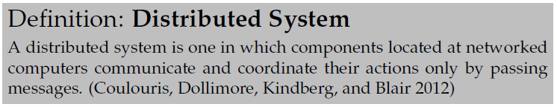
Distributed System
Why?
  To speed up computation
    Google search, machine learning, and (a few) other cases
  To share information
    Everything else! (Slight exaggeration!)

Slide 4
Limitations
Distributed systems and distributed computing is a…
We will limit ourselves to a ”niche”
… vast subject area !!!
Client-server Architectures using Remote Method Invocation
… this niche covers a lot of systems in practice ☺

Slide 5
And Limiting ourselves
Even that is
… because it must be
  Highly available, performant, and secure
And that is topics in advanced software architecture
… difficult to make!!!
We will only consider happy path:
All computers and networks are working;
Few users and none that are malicious

Slide 6
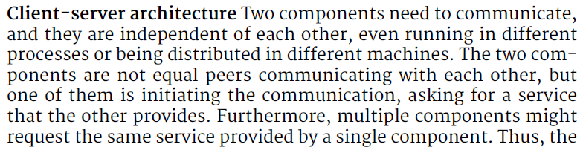
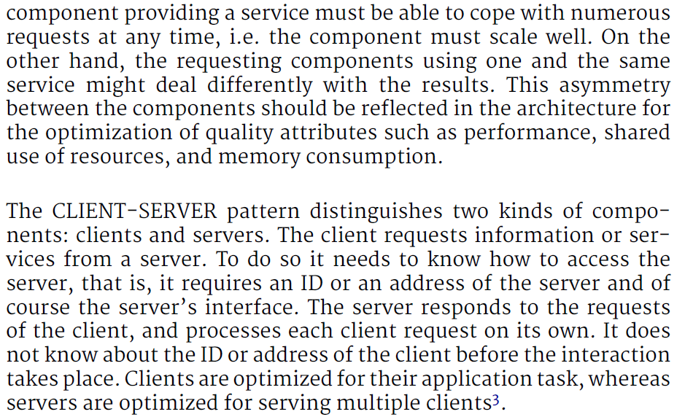
Client-Server
You all know ‘client-server’ architectures, but…
Reactive
Server
Active
Client
Client
Client
Client
Client
Ala: web browsing, facebook, …
Notes:
NOB Web of Things, Henrik Korsgaard Praksis,

Slide 7
Client-Server
One big difference from all you have been doing up until now…
  You have been building “programs” = all behavior in one ‘unit’
A client-server system consists of two programs
The client program: The one the user runs
  Communicating with…
The server program: Well hidden in some server room
  The one storing the ‘shared information’

Slide 8

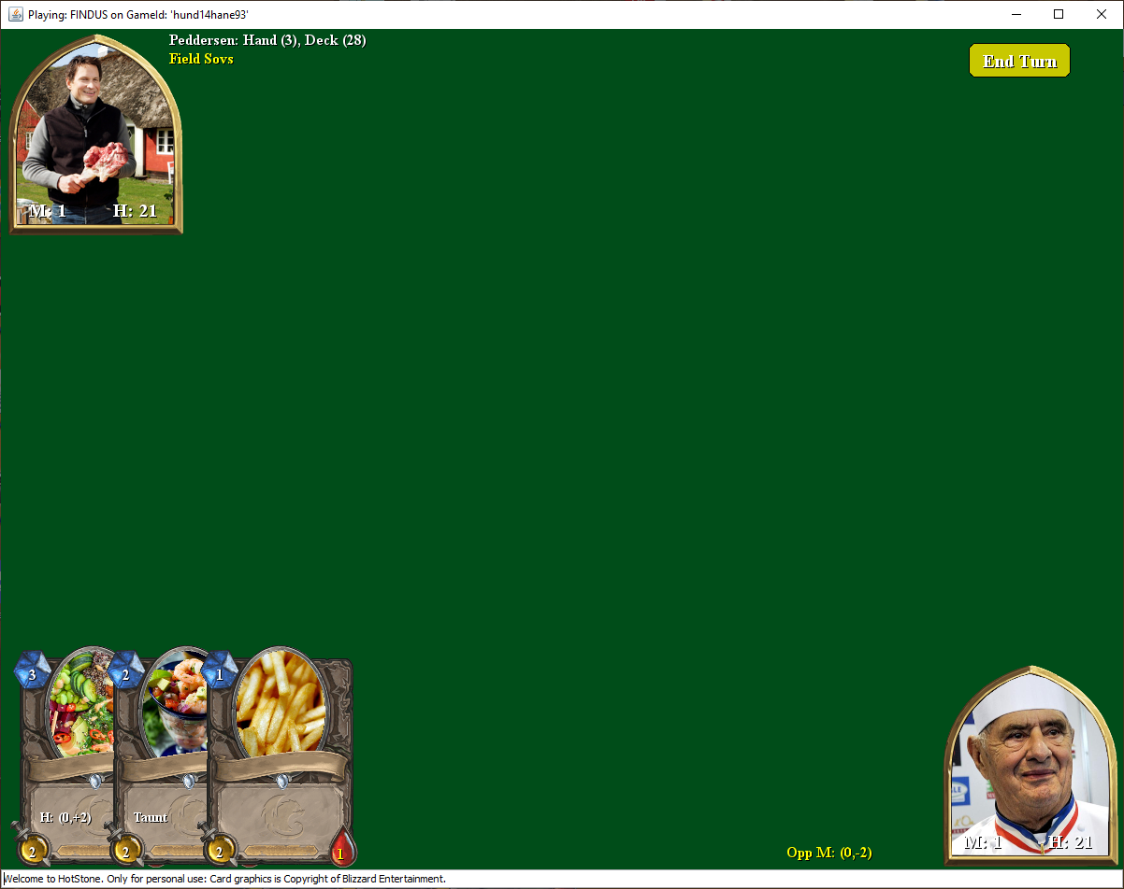
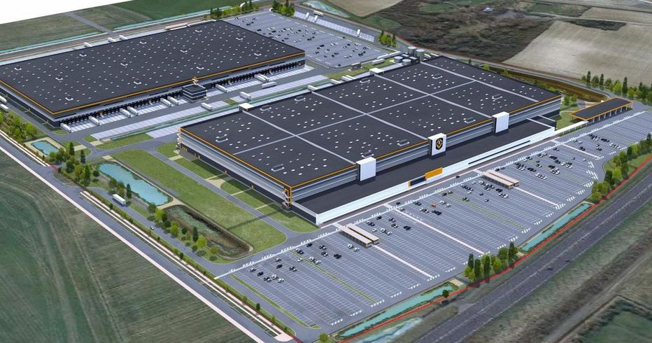

Or Visually
game.playCard(Findus, ff);
Client program
game.playCard(Findus, ff);
Server program

Slide 9
Or Visually
game.playCard(Findus, c) {
result =
sendToServer(“Findus tries to play ff”);
return result;
}
Await incoming command, c {
if (c == “Findus tries to play ff”) {
r = game.playCard(Findus,ff);
send ‘r’ back to client;
} else …
Client program
Server program

Slide 10
Or Visually
game.playCard(Findus, c) {
result =
sendToServer(“Findus tries to play ff”);
return result;
}
In the next two Iterations – you will build both the client program as well as the server program!
The server is the domain thing, remember!
Await incoming command, c {
if (c == “Findus tries to play ff”) {
r = game.playCard(Findus,ff);
send ‘r’ back to client;
} else …
Client program
Server program

Slide 11
One Word of Caution
We will happily disregard security !!!
Security is so important that we ignore it!
  Because the real security techniques is one big set of hard bindings and strong coupling
    You need certificates that tie you to a specific DNS name
      Certificate stores, key pair generation, trust chains, yaga yaga
    Quite a lot of extra coding and makes experiments difficult
Morale: Add that stuff for real production usage !

Slide 12
The History
Birrell and Nelson, 1984:
  “allow calling procedure on remote machines”
  A calls procedure f on B means
    A suspends, information on f is transmitted to B
    B executes the f procedure
    B sends the result back to A
    A resumes

Slide 13
Grounding Example
TeleMed
Inspired by Net4Care:
https://baerbak.cs.au.dk/net4care/

Slide 14
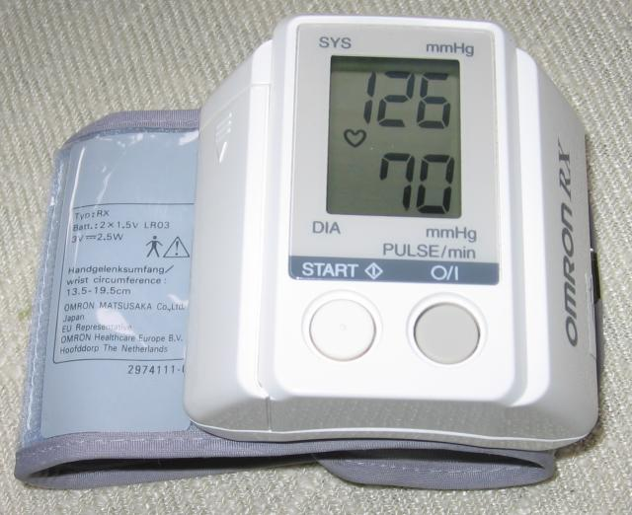
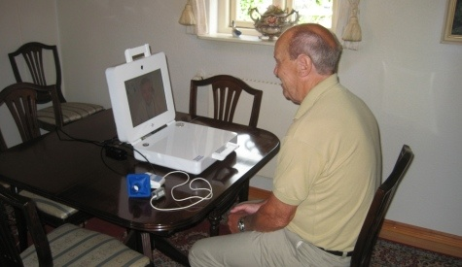
Vision
Vision
  Replace out-patient visits by
  measurements made by
  patients in their home
  Move data from home to
  regional/national storage so all
  health care personal can view them...
Motivation
  Reduce out-patient visits
    Better quality of life
    Cost savings
    Better traceability and visibility

Slide 15
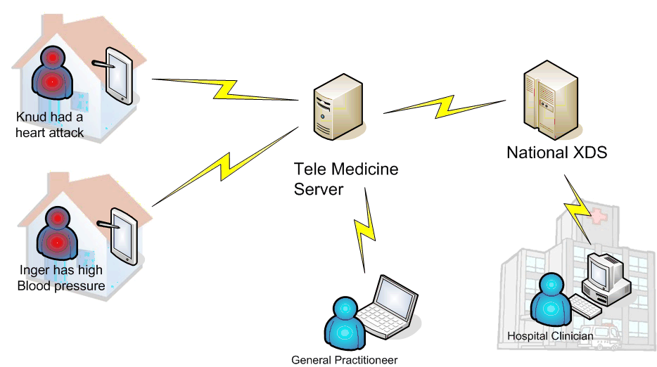
Story 1
2) BP measurement stored as HL7 document
1) Inger measures her BP
using her TeleMed terminal

Slide 16
Story 2
2) Query for all BP documents associated with Inger
1) GP queries last month’s BP
measurements for Inger using
web browser

Slide 17
(What is XDS)
Cross-Enterprise Document Sharing
  One Registry + Multiple Repositories
  Repository: Stores clinical documents
    (id,document) pairs
  Registry: Stores metadata with document id
    Metadata (cpr, timeinterval, physician, measurement type,...)
    Id of associate document and its repository
Think
  Registry = Google (index but no data)
  Repository = Webserver (data but no index)

Slide 18
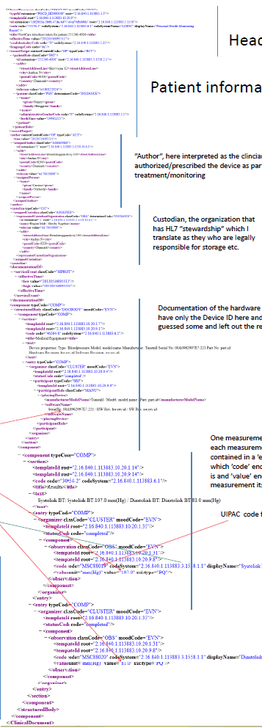
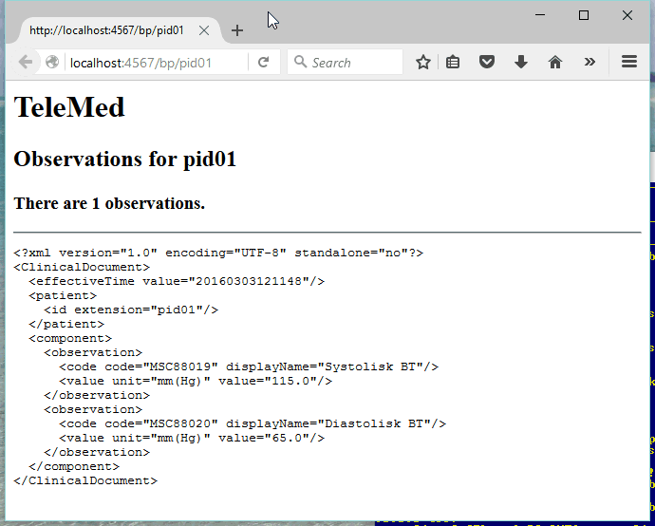
(What is HL7)
HL7 is a standard (complex!) for clinical
information storage and exchange.
  Version 3 loves XML!
Our version:
Real version:

Slide 19
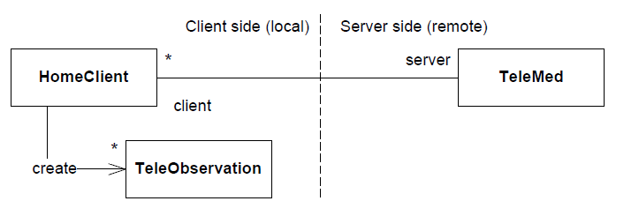
TeleMed Design
Roles involved
TeleObservation: Represents a measurement
HomeClient: Responsible for measuring + uploading
TeleMed: Responsible for storage and queries

Slide 20
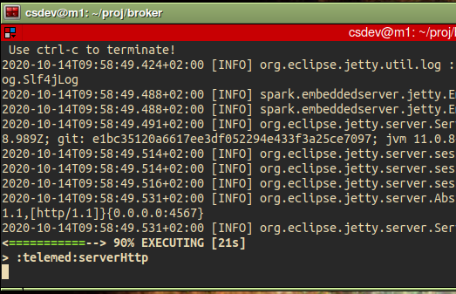
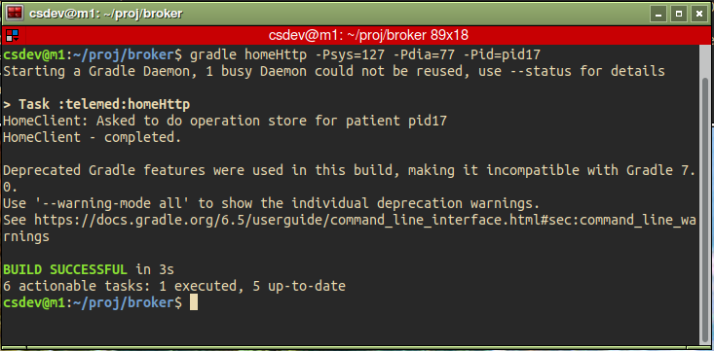
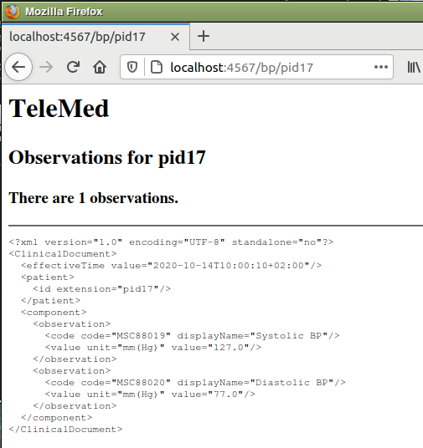
Demo
Start a server
  gradle serverHttp
Send an obs.
  gradle homeHttp
  … -Psys=126 -Pdia=70
  -Pid=pid17
GP review in browser
  http://localhost:4567/bp/pid17
Story 1
Story 2

Slide 21
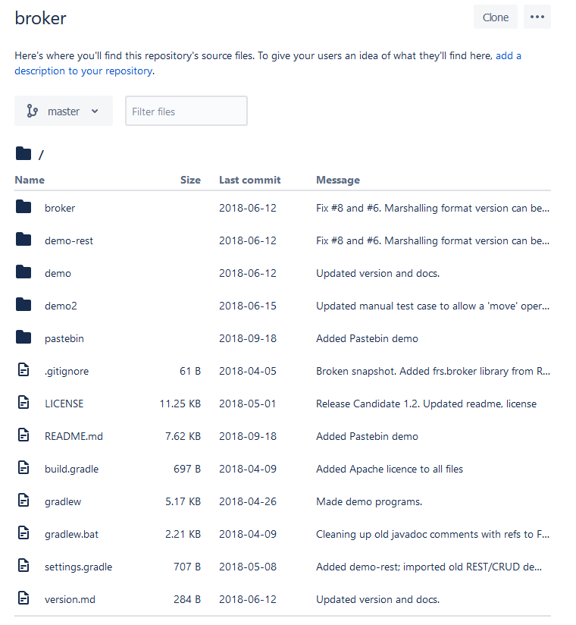
Source Code
The source code is open source at
  https://bitbucket.org/henrikbaerbak/broker/
  Download or Fork
You will want its code to learn the Broker pattern…
  But your HotStone mandatory
  only needs to fetch the Broker library using gradle…
    As with the MiniDraw library

Slide 22
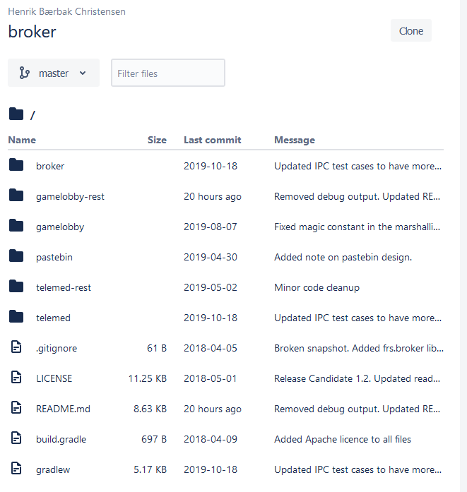
Source Code
Subprojects
  Broker: Core roles + default implementation of some
  TeleMed: The TeleMed code including tests of broker code
  Others: We will return to these next…

Slide 23
Issues in Distribution
Why is it hard?

Slide 24
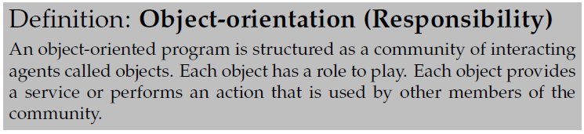
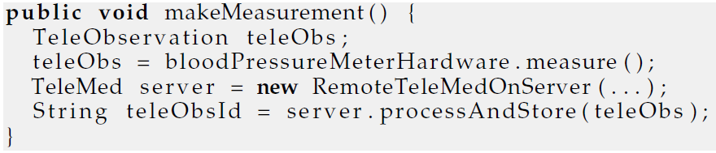
Challenge
How guys like me like to code:
Which is then something like this on the client:

Slide 25
Challenge
However - networks only support two asynch functions!
Which is not exactly the same as

Slide 26
Issues (at least!)
Send/receive is a too low level
programming model
Send() does not wait for a reply from server (Asynch)
Reference to object on my machine does not make sense on remote computer (memory address)
Networks does not transfer objects, just bits
Networks are slow
Networks and remote computers may fail
Networks are insecure, others may pick up our data
Security QA
Availability QA
Performance QA
Architectural Issues: Not SWEA stuff. (Follow my EVU course once you are in a job ☺)

Slide 27
Performance
Just how much slower is a network call compared to a local in-JVM memory call? Time for 10.000 uploads...
Imagine that your next trip to the supermarket for a soda was 275 times slower???
  10 minutes walk versus 46,8 hours walking ☺

Slide 28
Elements of a Solution
On the ‘happy path’, we need to
  Make the HomeClient invoke a synchronous method call on a remote TeleMed object using only network send/receive
  Keep our OO programming model: telemed.processAndStore(to);
    That is invoke specific method on remote object
  Convert TeleObservation object into bits to send it, and convert it back again
  Locate the remote TeleMed object

Slide 29
Elements Overview
Solutions are
  Request/Reply Protocol
    Simulate synchronous call (solves (partly) concurrency issue)
  Marshalling
    Packing objects into bits and back (solves data issue)
  Proxy Pattern
    Simulate method call on client (solves programming model issue)
  Naming Systems
    Use a registry/name service (solves remote location issue)
Bundled together these constitute
  The Broker pattern

Slide 30
Request/Reply

Slide 31
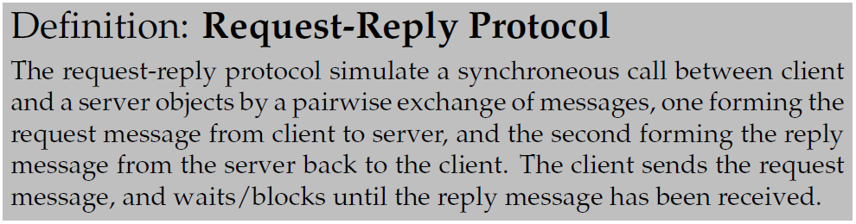
The Protocol
Known from every WWW access you have ever made…
  Firefox will block until a web page has been received

Slide 32
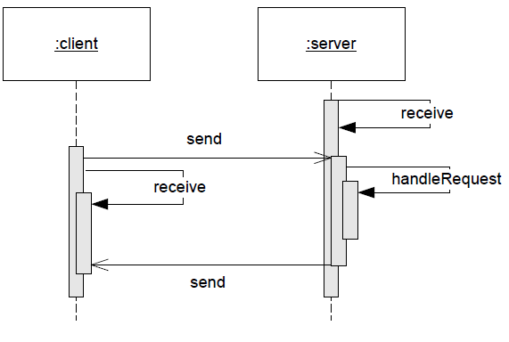
Pairing Send/Receives
Client does
  Send() and
  receive
Server does
  Receive() and
  send()
Roles
  Client is active – initiate action
  Server is reactive – awaits actions and then reacts

Slide 33
Marshalling
Or Serialization

Slide 34
Definitions

Slide 35
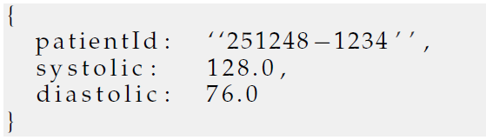
Two Basic Approaches
There are two approaches
  Binary formats
    Google ProtoBuf, proprietary
  Textual formats
    XML, JSON, proprietary
Exercise: Costs? Benefits?
JSON blood pressure

Slide 36
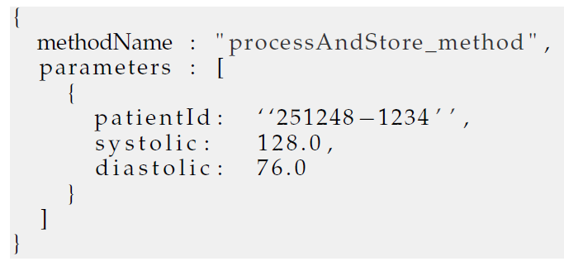
And we need more
As we can send only bits, we also need to marshal information about the method and object id!

Slide 37
Note
Marshalling is fine for primitive datatypes (int, double, char, array, …) but…
What about object references?
  inventory.addCustomer(c) where c is Customer object?
  Issue: the ‘c’ is an object reference but how to a use ‘c’ on the client if the object is located on the server?
Actually, it sort of depends on parameter passing…

Slide 38
Parameter Passing
Pass by reference
  The Java style for all object types
  You do not get the Customer value, you get a reference to it!
  public void addCustomer(Customer c);
    (‘c’ is a reference to data, not the data themselves)
Pass by value
  Java does this for primitive types, like int and double
  You do get the value itself
  public void deposit(double amount);
    (‘amount’ is the data (a copy of the value passed))

Slide 39
The Difference
Example: A HotStone Card
  Card c = new Card(Findus, “Tres”, 3, 3, 3);
  Now ‘c’ is a reference (pointer) to some data in memory
c:
reference to
Findus
Tres
3
3
3

Slide 40

The Difference
Example: A HotStone Card
  Card c = new Card(Findus, “Uno”, 1, 1, 1);
  At machine code level, c is simply
  the address of that chunk of memory
  Here I use hexadecimal
  numbers for addresses
c:
C013
Findus
Tres
3
3
3

Slide 41
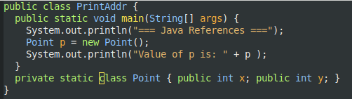

Java References
If you create a class, and do not override ‘toString()’ you get a glimpse of that memory address
  The JVM does some trickery so it is not a clean/real memory address, but anyway…

Slide 42
… The Problem
c = getCardInHand(…);
c:
C013
c:
C013 ???
Findus
Tres
3
3
3
Client program
C013 contains completely different data on the client ☹
Server program
Notes:
A memory address, defined server side, of course does not make sense client size: data is not organized in the same way on a completely different machine!

Slide 43
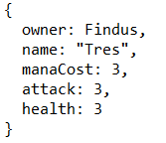
Broker Does Value Passing
The Key point here
That is, the server will not send the reference, but a marshalled copy of the data
  I.e. client receives
Broker only supports pass by value!
(next week we introduce a trick to simulate pass by ref)
Our Broker is not ‘stupid’. A network can by definition only support pass-by-value!

Slide 44
Consequences
If the server sends a card object – pass-by-value
And the client receives this object and then change
health
Then what happens in the server’s card object ???
health: 1
Quite problematic, right?
We solve it next week…
Notes:
Nothing. It is only client side the health changes, as it is a copy of the original object

Slide 45
JSON Libraries

Slide 46
Libraries
Every distributed system in the world needs to marshall!
Thus – lots of marshalling libraries around ☺
  Do NOT code it yourself!!! You will end reimplementing one!
    String json = ”{ name: ”+ object.name+ ”}…
JSON I have used many libraries
  Json-simple
  Jackson JSON
  Gson

Slide 47
Gson
Gson is the most compact I have used
  (But have had trouble with ‘date’ objects that marshall incorrectly!)
It allows easy marshalling of record types
  Also known as
    PODO: Plain Old Data Objects,
    DTO: Data Transfer Object
Record type (Pascal) / ‘struct’ (C) / record (java 17+)
  No complex methods, only set/get methods with no side effects
  Must have a default constructor
That is: A pure data object, just storing information
  Akin a ‘resource’ in REST terminology, by the way

Slide 48
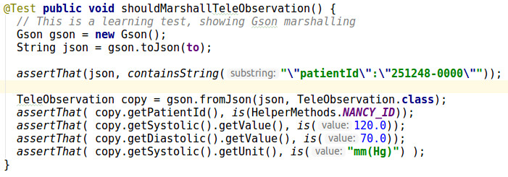
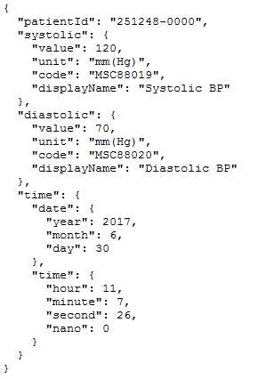
Example:
toJson(obj)
  Marshall
fromJson(str, type.class)
  Demarshall, using given type

Slide 49
Proxy
You know that one…

Slide 50
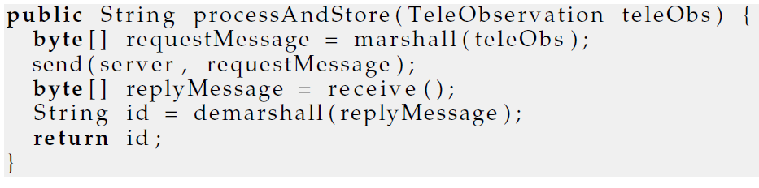
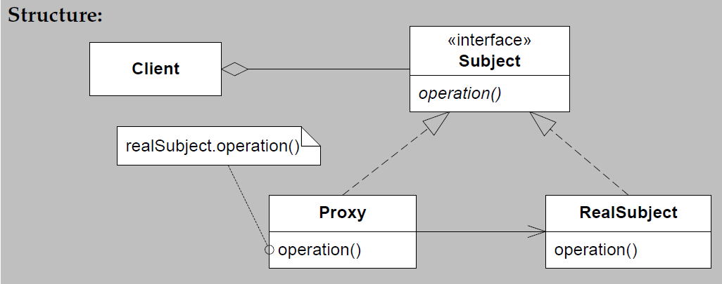
Example
TeleMedProxy
Client
Server
Network
call

Slide 51
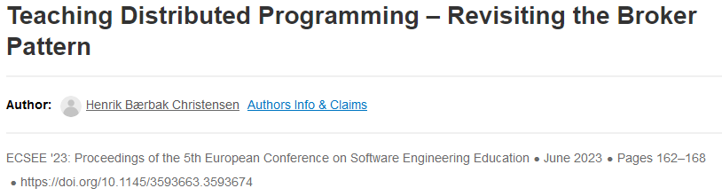
Note
The algorithm of all methods in the proxy will be the same
  Marshall parameters, send, await reply, demarshall, return
Can be auto generated – this is what RMI does
We will hand-code it, because
  … it is the learning goal of this course ☺
  And it actually makes sense if you want very strict control of architectural attributes like performance and availability
      Find more info in

Slide 52
Name Services
Finding the Object to Talk to

Slide 53
Coupling Proxy and ‘server-side’
OK, a Proxy “plays the client side role” of the real object on the server side…
But what if there are many ‘RealSubjects’?
  Like 52 instances of ‘Card’ objects on the server?
Client
Server
Network
call

Slide 54
The pass-by-reference problem!
Game.playCard(who, c, 1);
c1:
C013
c2:
C017
c:
???
c52:
C226
Client program
Server program
CS@AU
Henrik Bærbak Christensen
54
Notes:
‘c’ is some card on the client, but how do the client tell which of the many cards on the server side, it wants to play?

Slide 55
The Solution…
… is Name Services
  Which we will talk about next week
    (Basically just a mapping between a UUID and the objects)
This week we solve it simply by
  Having only one object!!!
    Known as a ‘singleton’ only one object like it in the world
  There is only one “TeleMed” object
  (And in mandatory, there is only one Game object)

Slide 56
Summary
The Broker Pattern combines
  Request/Reply protocol
  Marshalling
  Proxy pattern
  Naming Systems (next week)
… to produce something that (on happy days)
Allows an Object-Oriented Programming model to apply to distributed computing

